Slide 1
Class-Imbalance Learning
Leonidas Constantinou

Slide 2
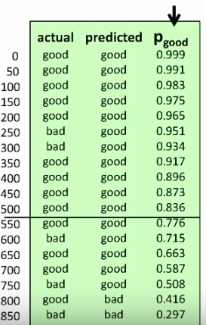
Problem statement
Extremely common in practice
Fraud detection,
Anomaly detection
Medical diagnosis
Solutions
Sampling methods
Cost sensitive learning
Sampling methods/Bagging
Oversampling
Duplicating the minority classes →over fit
Under sampling
Throws away many potential useful data
SMOTE (Synthetic Minority Over-Sampling Technique)
Under-samples + Oversamples
Oversampling by constructing new minority class data instance via an algorithm
Cost sensitive classification
Adjust the probability threshold
Cost sensitive learning
Bagging: Generate N subsets from the original train N models in parallel. Final decision is the majority vote
Boosting:
Like bagging but in sequence
Generate one subset, train a model,
Use the badly classified instances to generate the next bag and train a new model.
Repeat the process for N times.
Final decision is the majority of the votes
Adaboost:

